Slide 1
SVM
eng,.Mahmoud Ragab

Slide 2
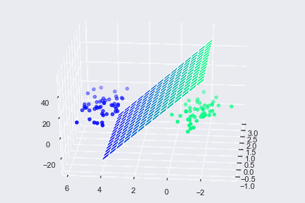
What is svm ?
It is a method of Supervised Learning ,It has many important applications .
such as:
face recognition
photo rating
Handwriting recognition
It is similar to the classification, but has several differences

Slide 3
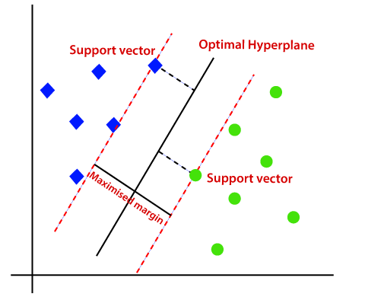
Idea :-
His idea is to classify the data with an imaginary line, provided that there is a barrier separating the points from each other
The barrier is called optimal hyperplane
The closest distance between two different points is called the max margin
The line that marks the end of each part is called Support Vector

Slide 4
difference between svm & lr
Element
LR
SVM
The closest distance between two different elements
small and sometimes overlapping
big
Speed
slow down
Faster
data separator type
linear separator
non-linear separator
The function used
sigmoid function
Sigmoid function and others
When is Y = 1 ?
The value of Ŷ is greater than 0
The value of Ŷ is greater than 1
When is Y = 0 ?
The value of Ŷ is less than 0
The value of Ŷ is less than -1

Slide 5
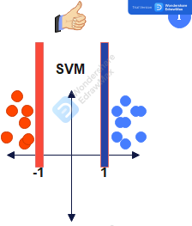
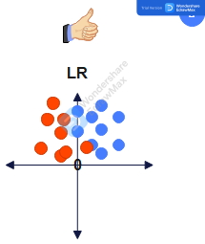

Slide 6
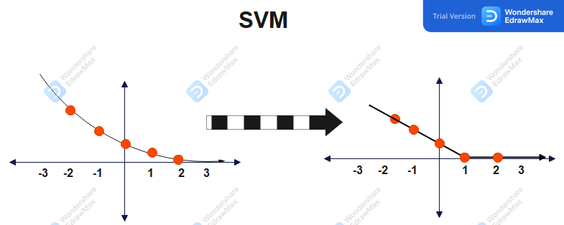
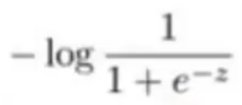
first case Y = 1
the greater the value of Z, the closer the Y to 0
The sharp change in the curve occurs at point 1
Cost 1

Slide 7
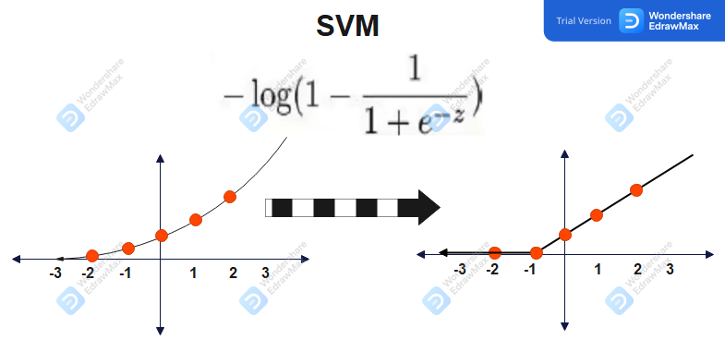
second case Y = 0
The higher the value of Z , the higher the value of Y
The lower the value of Z, the closer Y gets to 0
The sharp change in the curve occurs at point -1
Cost 0

Slide 8
Svm equation
As the value of C increases, the value of A decreases, and thus the value of B increases
The value of b is what is next to the theta, and if it is large, this means that any change in the value of the theta will have a sharp effect on the value of J.
This will lead to overfitting and excessive sensitivity
CA + B

Slide 9
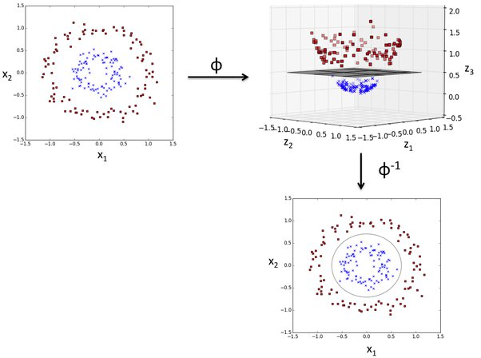
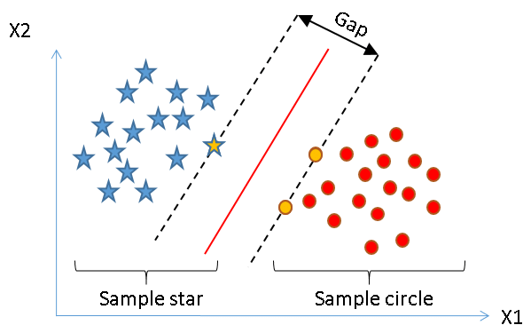
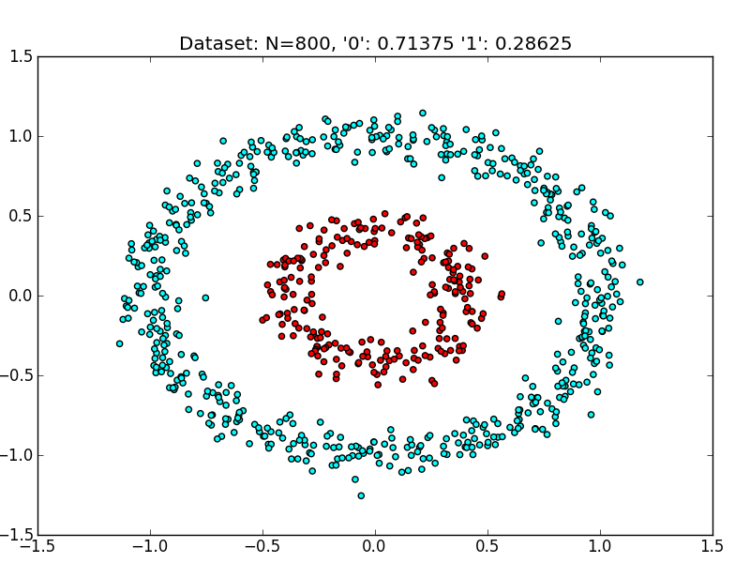
distance
The distance between the points is linear or non-linear

Slide 10
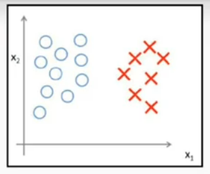
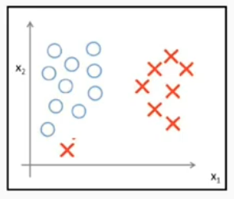
Over Fitting

Slide 11
Under Fitting

Slide 12
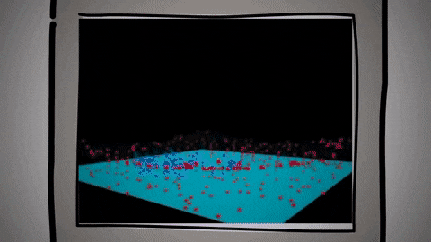
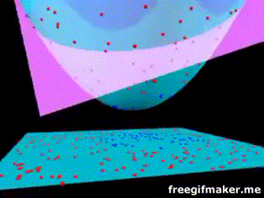
concept of the kernel
The similarity function given by two inputs to each other ( images and speech, sound and speech ) and the function determines the amount of similarity between them
I mean, simply, the kernel is a function with complex calculations. We call it easily so that we can replace it with the inputs, and it calculates the outputs as an alternative to dealing with many complex features.

Slide 13
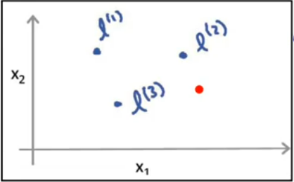
Mean of kernel
How to calculate how close or far a specific point is from a number of points in the system
This is done by using the similarity kernel
The mathematical function called: Gaussian Kernel is used

Slide 14
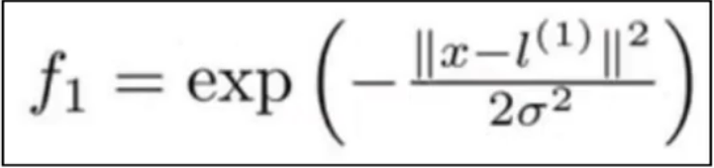
Gaussian Kernel equation

Slide 15
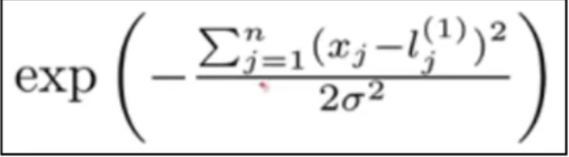
Close values
When the values ​​of x are close to each other, the difference is small and approaches zero
and therefore everything inside the expository approaches zero
so the value of f (exponential zero) is equal to or close to 1

Slide 16
Far values
when the | , x are far from each other, the difference is large
therefore everything inside the exponential negative is a large number
so the value of f (exponential large negative number), is equal to or close to 0

Slide 17
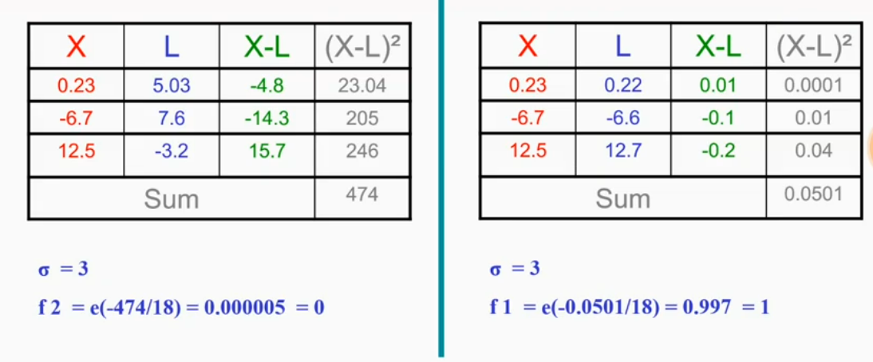
Close values
far values

Slide 18

any questions ?

